Slide 1
X-RAY DETECTION USING CNN
PRESENTED BY: Deepak B
REGISTER NO:711721243021
DEPARTMENT:ARTIFICIAL INTELLIGENCE AND DATA SCIENCE
3/21/2024 Annual Review

Slide 2
PROJECT TITLE
X-RAY DETECTION USING CNN
3/21/2024 Annual Review

Slide 3


AGENDA
1.Problem Statement
2.Project Overview
3.End users
4.Our Solution and its value Proposition
5.Modelling Approach
6.Result and Evaluation
7.Conclusion
3/21/2024 Annual Review

Slide 4

PROBLEM STATEMENT
The objective is to create a system using Convolutional Neural Networks (CNNs) that can precisely identify and categorize objects or abnormalities in X-ray images.
This encompasses tasks like identifying and pinpointing different anomalies within objects, categorizing these identified objects, managing diverse image qualities like resolution, noise, and lighting differences, gathering and labeling data effectively, ensuring the model's decisions can be understood and trusted, and dealing with regulatory and ethical issues for practical application.
3/21/2024 Annual Review

Slide 5

PROJECT OVERVIEW
The project aims to utilize Convolutional Neural Networks (CNNs) to create a reliable system capable of accurately detecting and categorizing objects or abnormalities present in X-ray images.
Critical elements involve thorough data gathering and preprocessing to guarantee diversity and quality within the dataset. Crafting custom CNN structures, along with training and enhancing them using advanced methodologies, are pivotal for enhancing model performance and its ability to generalize.
.
We will deploy algorithms for object detection and localization, as well as techniques for anomaly classification, to accurately pinpoint and classify anomalies in X-ray images. We will use evaluation metrics to thoroughly evaluate the model's performance on real-world datasets, guaranteeing its robustness and dependability.
3/21/2024 Annual Review

Slide 6

WHO ARE THE END USERS?
The users who utilize Convolutional Neural Networks (CNNs) for X-ray detection can differ based on the particular field of application. Below are potential user groups across various sectors:
Medical Professionals
Security Personnel
Industrial Inspectors
Research Institutions
Emergency Responders
Government Agencies
Private Sector Companies
Educational Institutions
3/21/2024 Annual Review

Slide 7

OUR SOLUTION AND ITS VALUE PROPOSITION
Our innovative method employing Convolutional Neural Networks (CNNs) for X-ray detection stands at the forefront, ready to transform the landscape of X-ray image analysis.
Its sophisticated algorithms and resilient training methods guarantee dependable performance across various datasets and imaging scenarios, providing reliable outcomes even in difficult conditions..
Additionally, we place importance on making our solution interpretable and understandable. This involves offering users insights into how the model makes decisions through easy-to-understand visual representations.
Our solution provides a thorough and economical approach to improving X-ray image analysis, incorporating scalability, smooth integration, and ethical standards. This results in notable enhancements in accuracy, efficiency, and operational effectiveness for our users.
3/21/2024 Annual Review

Slide 8

THE WOW IN OUR SOLUTION
Breakthrough Accuracy
Real-time Efficiency
Adaptability to Varied Conditions
Intuitive Interpretability
Seamless Integration and Scalability
Ethical and Regulatory Compliance
Transformative Cost-effectiveness
3/21/2024 Annual Review

Slide 9
MODELLING
Data Preparation:
1. Acquire the X-ray image dataset, ensuring it adheres to proper formatting and includes accurate annotations with ground truth labels.
2. Partition the dataset into training, validation, and test subsets to facilitate effective model assessment.
3. Execute preprocessing procedures, such as resizing, normalization, and augmentation, to enhance the quality and diversity of the dataset.
Model Architecture Design:
1. Opt for a suitable CNN architecture tailored specifically for X-ray image analysis, such as VGG, ResNet, or DenseNet.
2. Customize the selected architecture to accommodate the unique characteristics of X-ray images, notably their high contrast and grayscale properties.
3. Integrate additional layers or adaptations as necessary to optimize the model for both object detection and classification tasks.
Training and Optimization:
1. Initialize the CNN model with appropriate weights or utilize pre-trained models, leveraging transfer learning methods to expedite training.
2. Define pertinent loss functions, such as categorical cross-entropy or binary cross-entropy, contingent upon the classification objective.
3. Employ optimization algorithms like Stochastic Gradient Descent (SGD), Adam, or RMSprop to minimize the loss function and iteratively update model parameters.
4. Fine-tune hyperparameters including learning rate, batch size, and regularization techniques to enhance model convergence and generalization.
3/21/2024 Annual Review

Slide 10
Object Detection and Localization:
1. Embedding algorithms for detecting and pinpointing objects within the CNN framework, like Region-based CNNs (R-CNN), Single Shot Detectors (SSD), or You Only Look Once (YOLO).
2. Refining the detection and localization layers to precisely identify objects or abnormalities in X-ray images while minimizing false alarms.
Anomaly Classification:
1. Integrating classification layers into the CNN architecture to categorize identified objects or anomalies into relevant classes.
2. Employing activation functions such as softmax for multi-class classification or sigmoid for binary classification, depending on the class count.
Model Evaluation:
1. Assessing the CNN model's performance through suitable metrics like accuracy, precision, recall, F1-score, and area under the Receiver Operating Characteristic (ROC) curve.
2. Validating the model on a separate validation set and gauging its generalization ability on unseen test data.
3. Tweaking model parameters or architecture based on validation results to enhance overall performance.
Interpretability and Explainability:
1. Utilizing methods to interpret and elucidate the model's decisions, such as generating heatmaps, saliency maps, or attention mechanisms to highlight significant areas within X-ray images.
Deployment and Integration:
1. Deploying the trained CNN model for real-world applications, seamlessly integrating it with existing X-ray imaging systems or workflows.
2. Creating user-friendly interfaces or APIs to streamline integration and interaction with the CNN-based X-ray detection system.

Slide 11
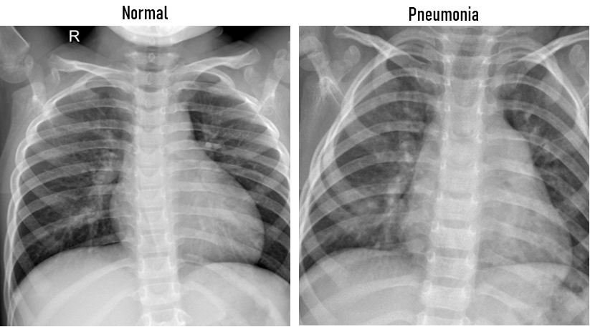
RESULTS
Demo Link
3/21/2024 Annual Review

